Slide 1
Unit 1 – Binary Systems

Slide 2
Analog Systems
Analog systems handle continuous signals, where information is represented by variations in physical quantities such as voltage, current, or frequency.
These systems can represent an infinite range of values.
Characteristics:
Signals vary continuously.
Prone to noise and distortion over time or distance.
More suitable for representing real-world phenomena like sound and light.

Slide 3
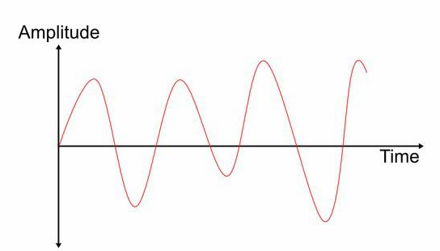

Slide 4
Digital Systems
Digital systems process discrete signals, where information is encoded in binary form (0s and 1s).
Digital systems represent values using specific, finite steps.
Characteristics:
Signals are discrete and represented in binary (0 or 1).
More resistant to noise and distortion.
Data can be processed, stored, and transmitted more efficiently.

Slide 5
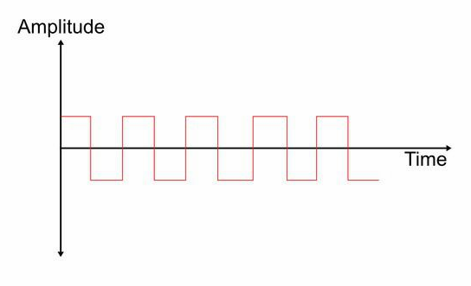

Slide 6
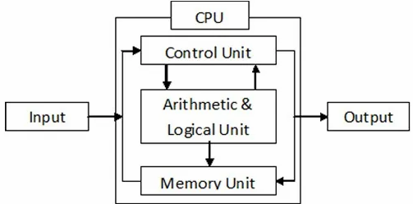
Block Diagram of Digital Computer

Slide 7
Working Principle of Digital Computer
Memory unit stores programs as well as input, output and intermediate data.
The control unit supervises the flow of information between various units and retrieve the instructions stored in memory unit.
After getting control signal memory unit sends the data to the processor.
For each instruction control unit informs the processor to execute the operation according to the instruction.
After getting control signal processor sends the process information to memory unit and memory unit sends those information to the output unit.

Slide 8
Number System - Introduction
Class Discussion

Slide 9
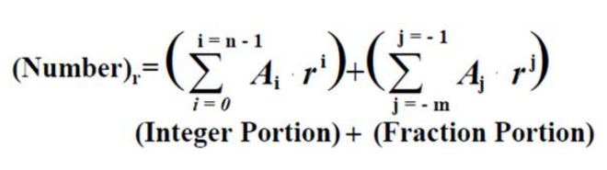
Number Based Conversion
Power Series:

Slide 10
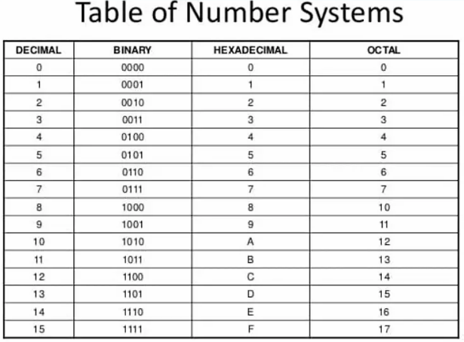

Slide 11
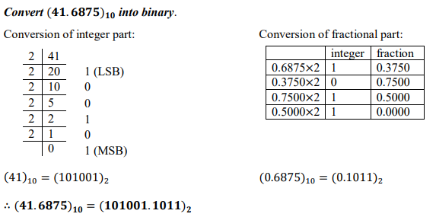
Decimal to Binary

Slide 12
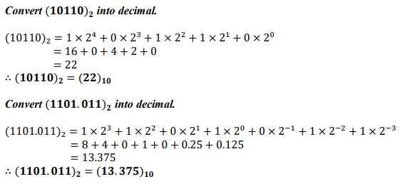
Binary to Decimal

Slide 13
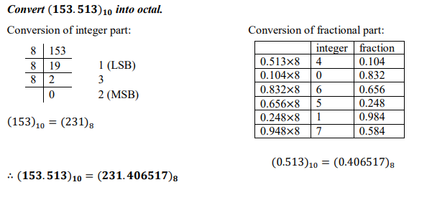
Decimal to Octal

Slide 14
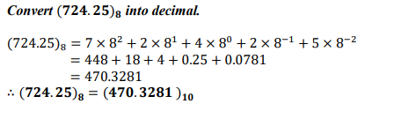
Octal to Decimal

Slide 15
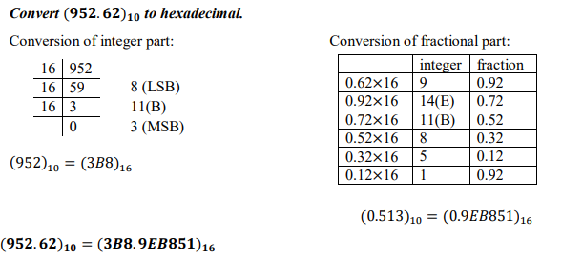
Decimal to Hexadecimal

Slide 16
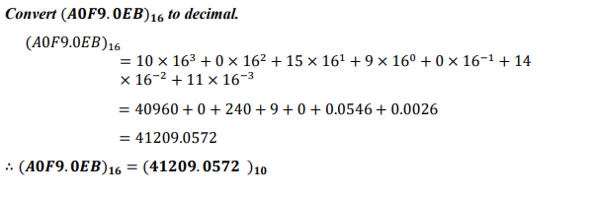
Hexadecimal to Decimal

Slide 17
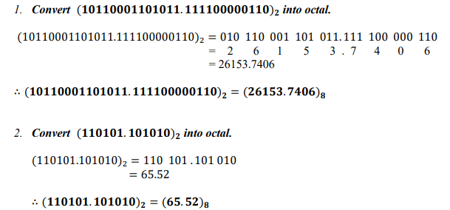
Binary to Octal

Slide 18
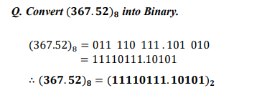
Octal to Binary

Slide 19
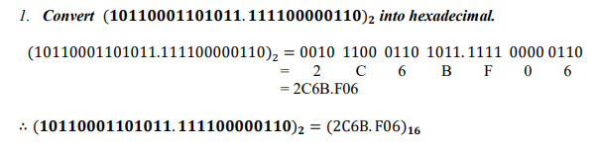
Binary to Hexadecimal

Slide 20
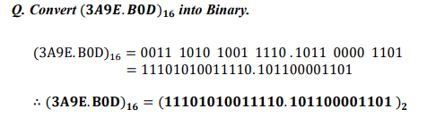
Hexadecimal to Binary

Slide 21
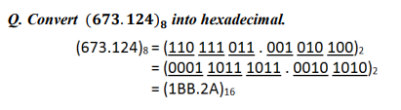
Octal to Hexadecimal

Slide 22
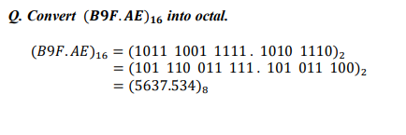
Hexadecimal to Octal

Slide 23
Complements
used in the digital computers in order to simplify the subtraction operation and for the logical manipulations.
r’s complement
(r-1)’s complement

Slide 24

R’s Complement (10’s and 2’s)
Given a positive number 𝑁 in base 𝑟 with an integer part of 𝑛 digits, the 𝑟’𝑠 complement of 𝑁 is defined as;
The r’s complement of N is
N = $\left\{{rn−N ; if N ≠0 \atop 0 ; if N=0}\right.$

Slide 25
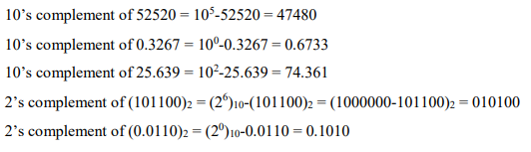
Example

Slide 26
(R-1)’s Complement
Given a positive number 𝑁 in base 𝑟 with an integer part of 𝑛 digits and a fractional part of 𝑚 digits, the (𝑟 − 1)’𝑠 complement of 𝑁 is defined as:
The (r-1)’s complement of N is
N = r^{n} – r^{-m} – N

Slide 27
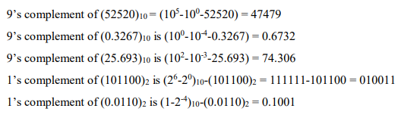
Example

Slide 28
Subtraction with r’s Complement
Subtraction of any two positive numbers M and N .i.e. (M - N), both of base r, may be carried as;
Add the minuend (M) to r’s complement of subtrahend (N)
Inspect the result obtained in first step for and end-carry;
If an end-carry occurs, discard it.
If not, take the r’s complement of the number obtained in first step and place a negative sign in front.

Slide 29
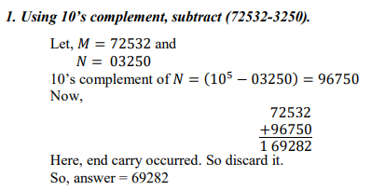
Example

Slide 30
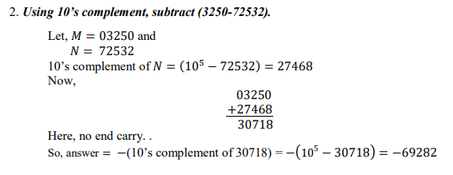

Slide 31
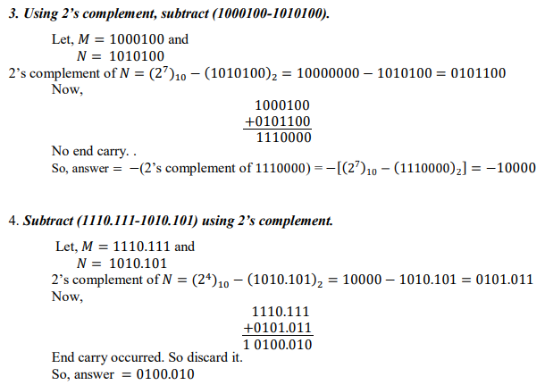

Slide 32
Subtraction with (r-1)’s Complement
Subtraction of any two positive numbers M and N .i.e. (M - N), both of base r, may be carried as;
Add the minuend (M) to the (r-1)’s complement of the subtrahend N
Inspect the result obtained above for an end-carry
If an end-carry occurs, add 1 to the least significant digit
If not, take the (r-1)’s complement of the number obtained in first step and place a negative sign in front

Slide 33
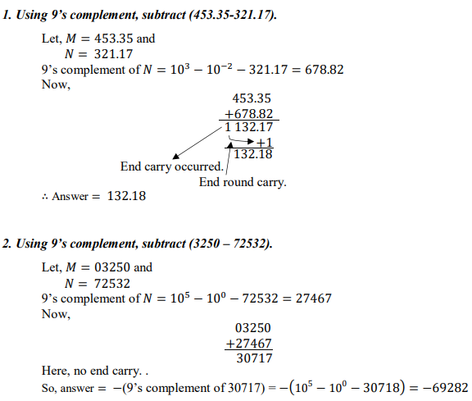

Slide 34
